Slide 1
MULTIMEDIA ADVERTISING AGENCY BHOPAL SINCE 1984
BHOPAL CITY PLAN

Slide 2
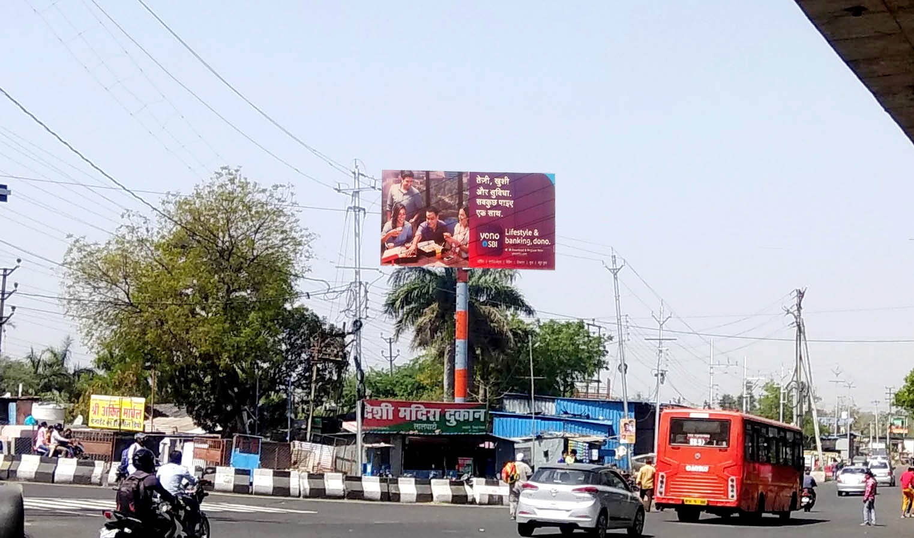
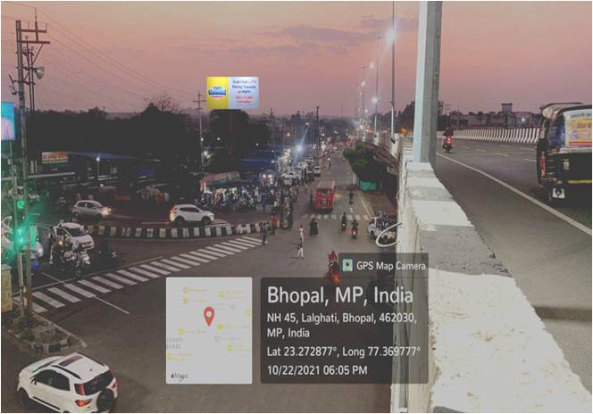
lalghati sqaure vip raod towards bus stand
FIRST VIEW size 30x15 – LIT --- Rs 5000/day latitude longitude 23.2726650, 77.3695270

Slide 3
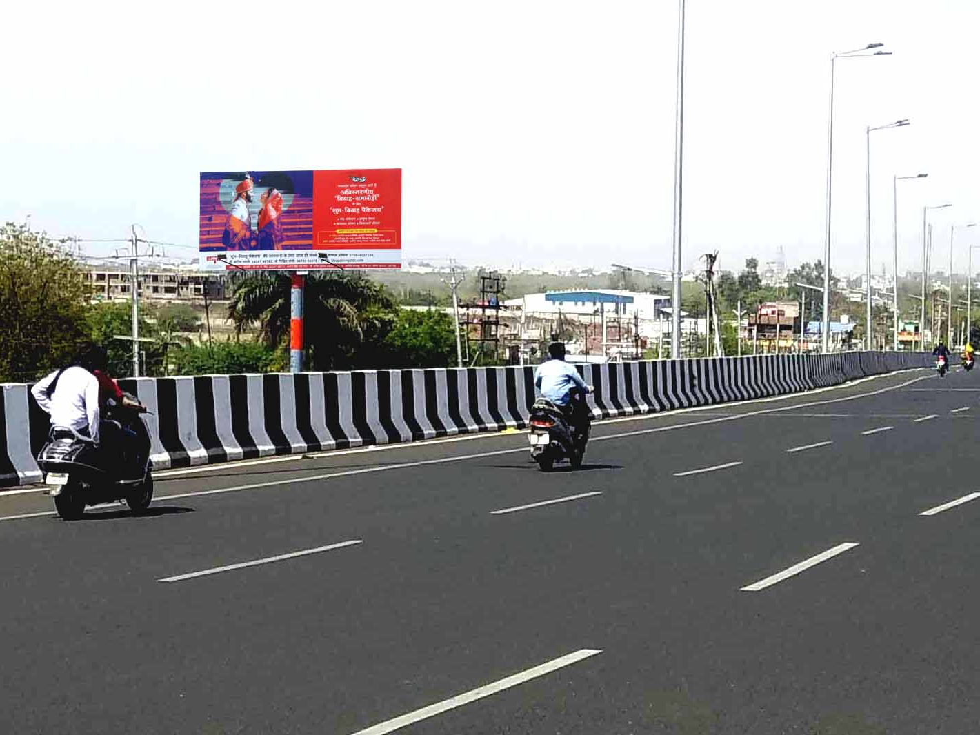
VIP SQUARE OVER BRIDGE NEAR KOHEFIZA BHOPAL SECOND VIEW - LIT
SIZE : 30X15 latitude longitude 23.2726650, 77.3695270

Slide 4
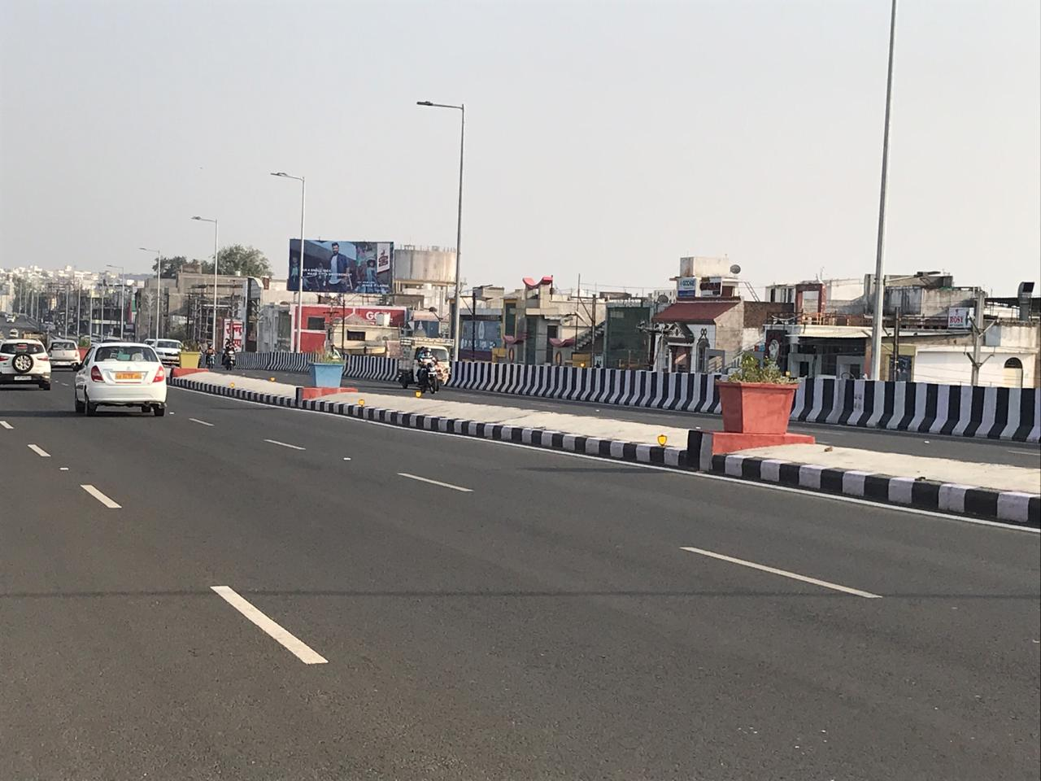
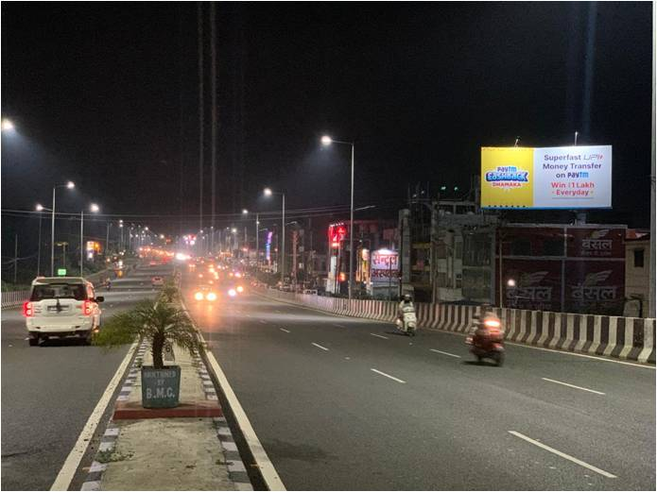
AIRPORT TOWARDS LALGHATI VIP ROAD BHOPAL 40X20 - LIT
FAR VIEW Rs – 200000/month Rs 10000/day latitude longitude 23.2827335, 77.3583479

Slide 5
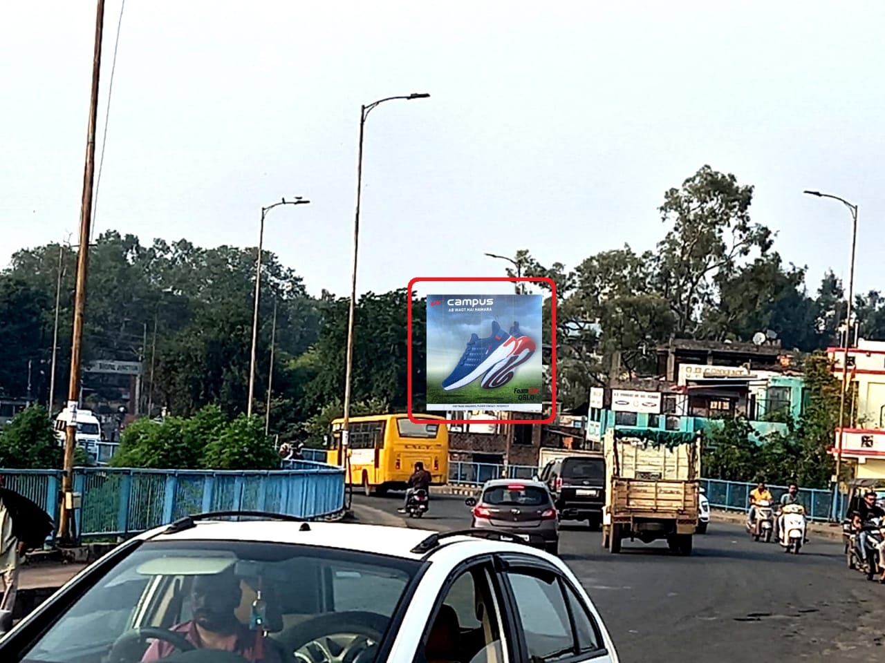
Railway station over bridge towards 1 no. plateform
20x20 Rs 120000/month Rs 5000/day
latitude longitude 23.2633583, 77.4130821

Slide 6
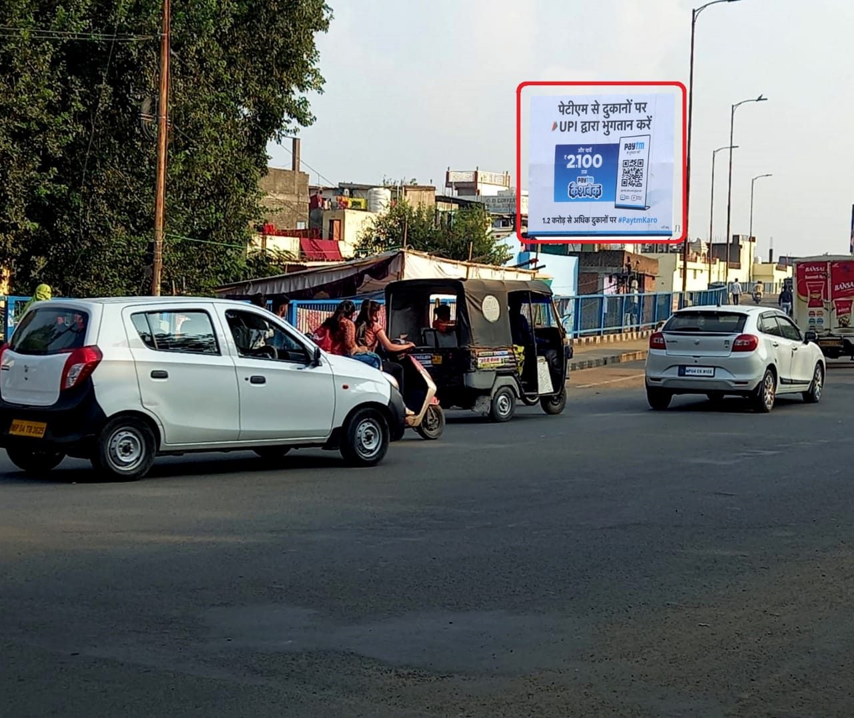
Railway station over bridge towards 6 no. plateform
20x20 Rs 120000/month Rs 5000/day
latitude longitude 23.2633583, 77.4130821

Slide 7
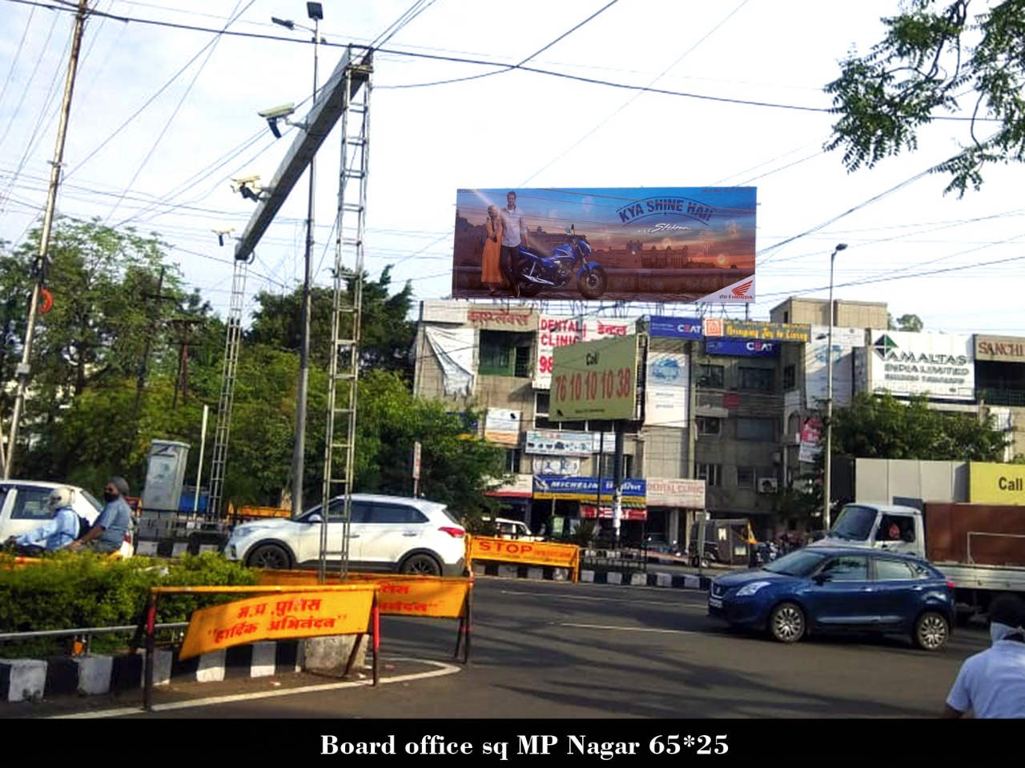
M.P nagar board office square 65x25 LIT
Rs 1400000 /month Rs 50000/day
latitude longitude 23.2309541, 77.4325435

Slide 8
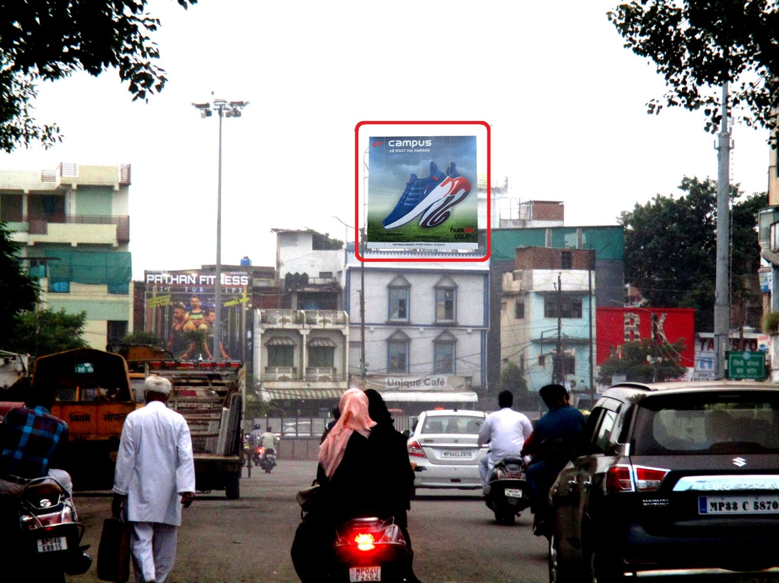
Bogda pul to m.p nagar 20x20 - LIT
20x20 Rs 120000/month Rs 5000/day
latitude longitude 23.2500090, 77.4237744

Slide 9
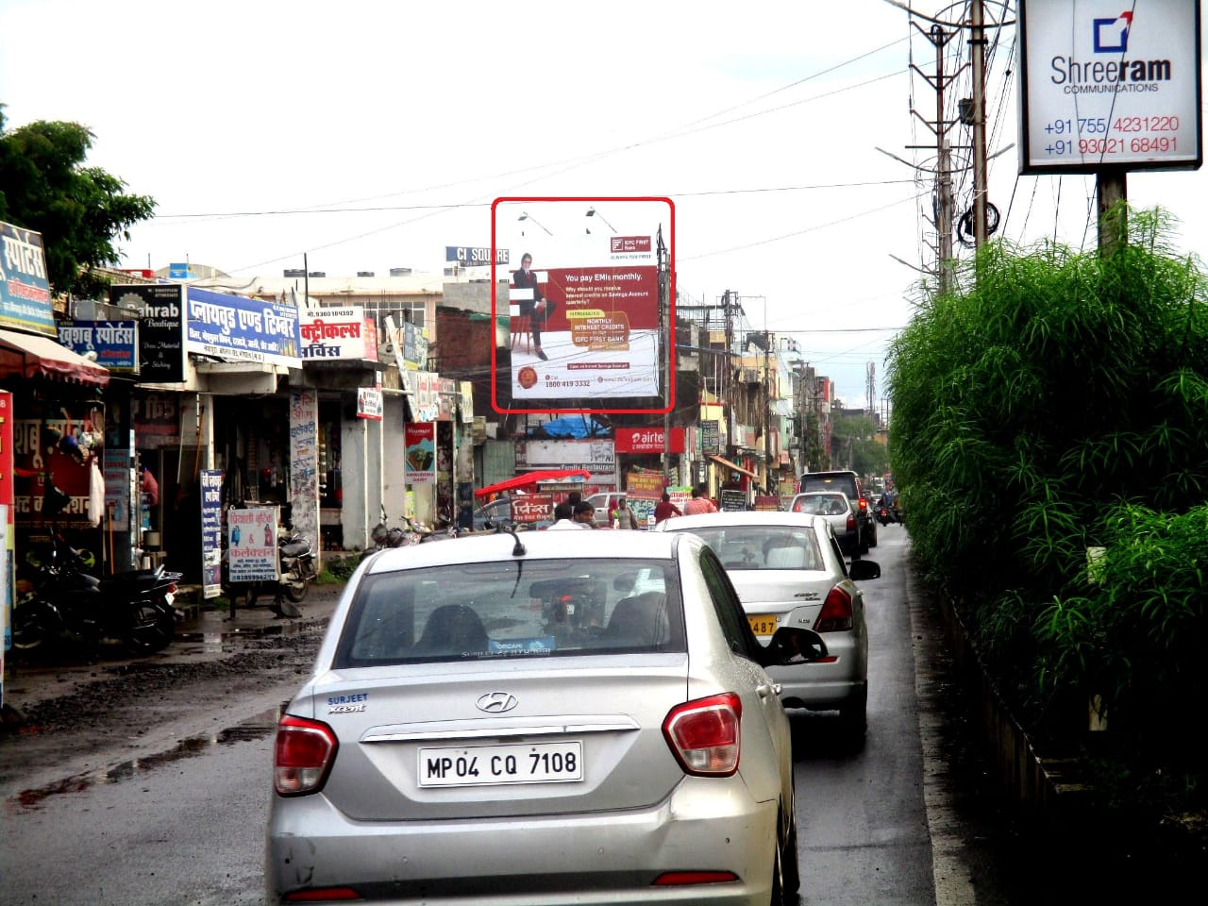
Kolar main road 20x20 - LIT
20x20 Rs 120000/month Rs 5000/day
latitude longitude 23.1772037, 77.4176623

Slide 10
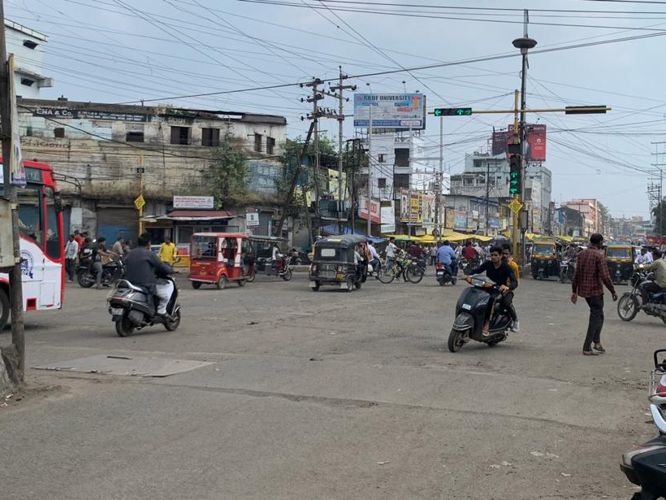
Bhopal Talkies Square 30x15 - LIT
Rs 140000/month Rs 5000/day
latitude longitude 23.2663660, 77.4008180

Slide 11
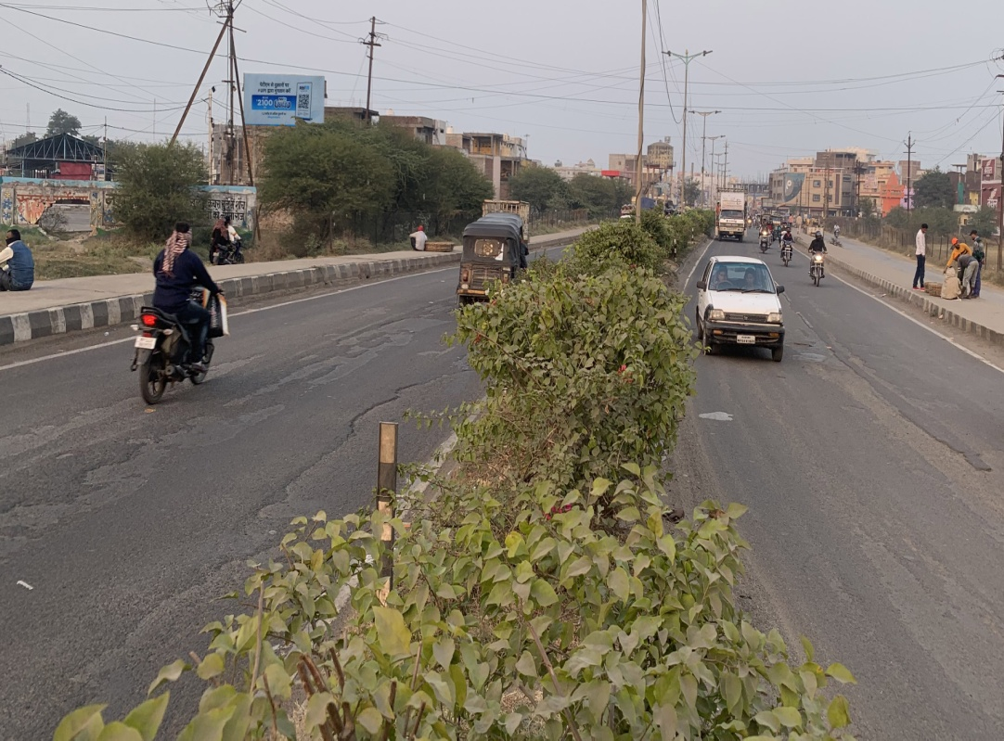
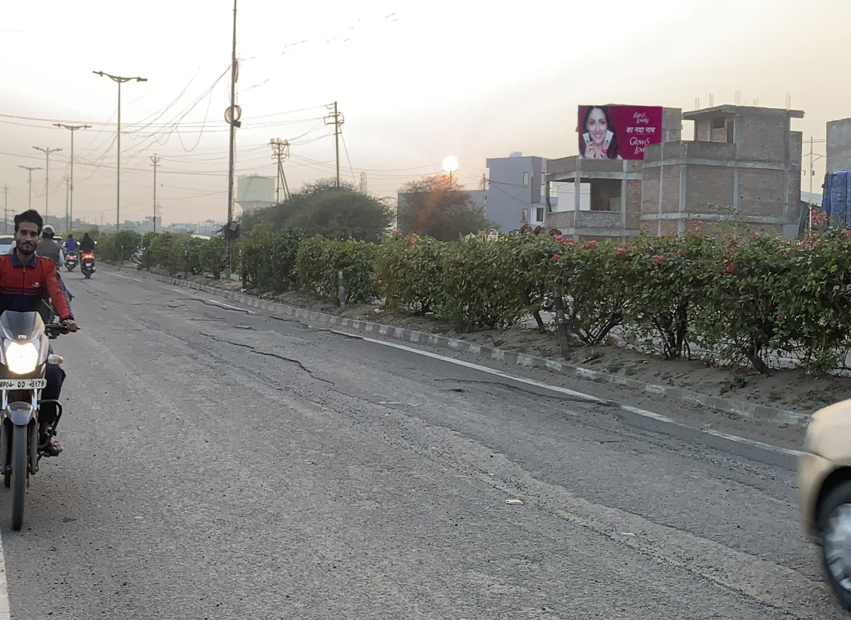
BHOPAL KAROND MANDI TOWARD PEOPLES MALL – NLIT 20x10
Rs 10000/month Rs 500/day latitude longitude 23.2876821, 77.4112927

Slide 12
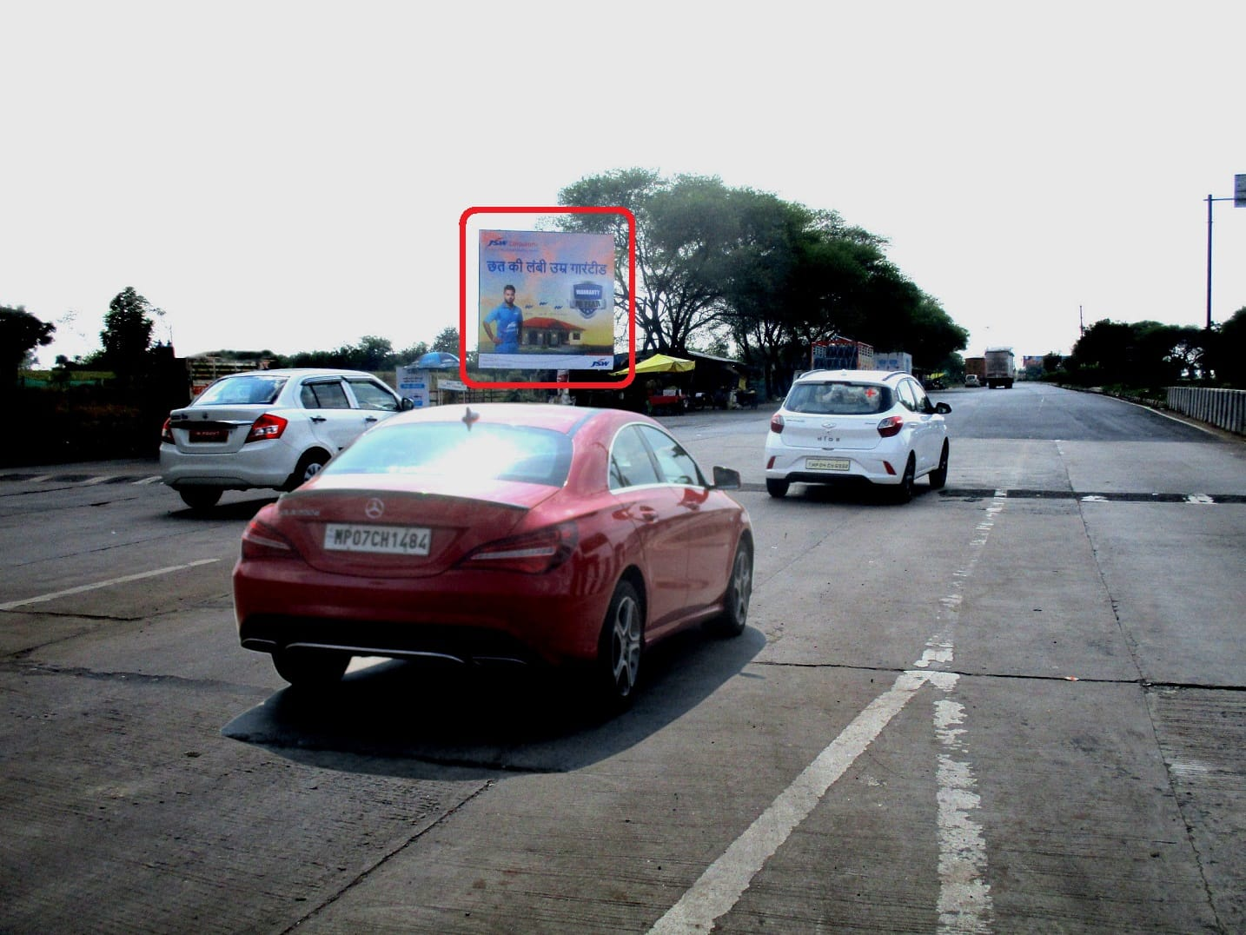
Ahead of Sehore naka indore highway 20x20 - NLIT
Rs 30000 /month Rs 1500/day
latitude longitude 23.2876821, 77.4112927

Slide 13
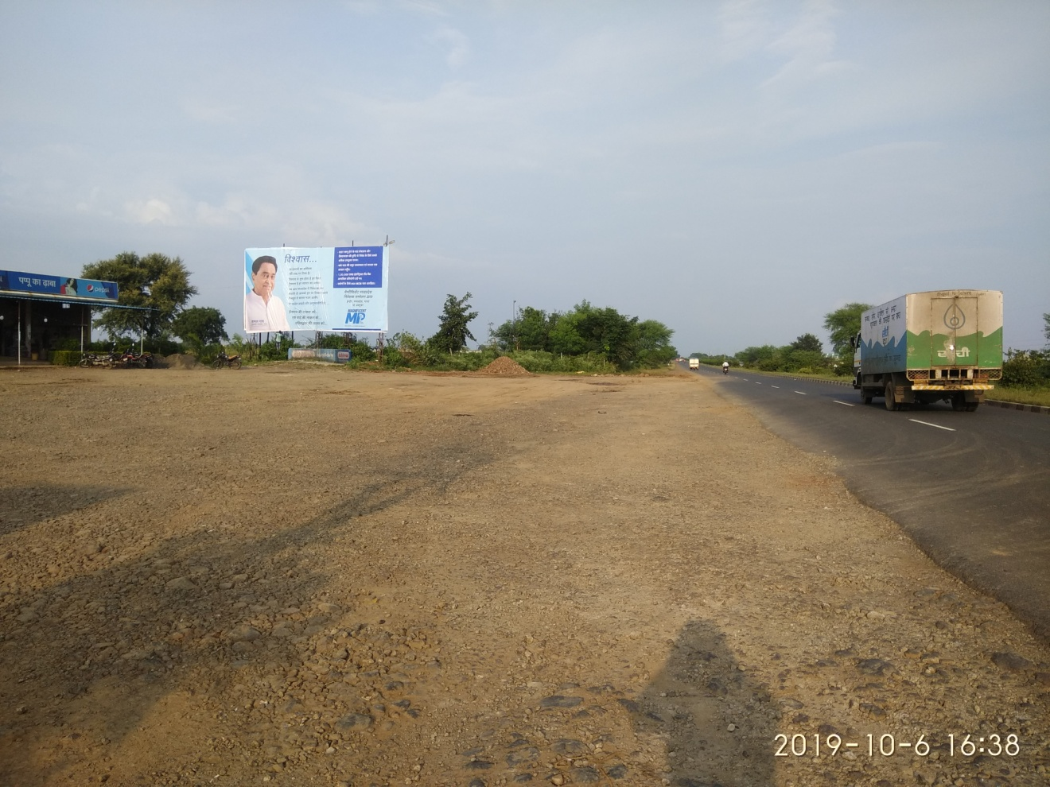
CRESENT PARK TO BHOPAL TOLL TAX
40X20 Rs 750000 /month Rs 3000/day
latitude longitude 23.1829710, 77.0836515

Slide 14
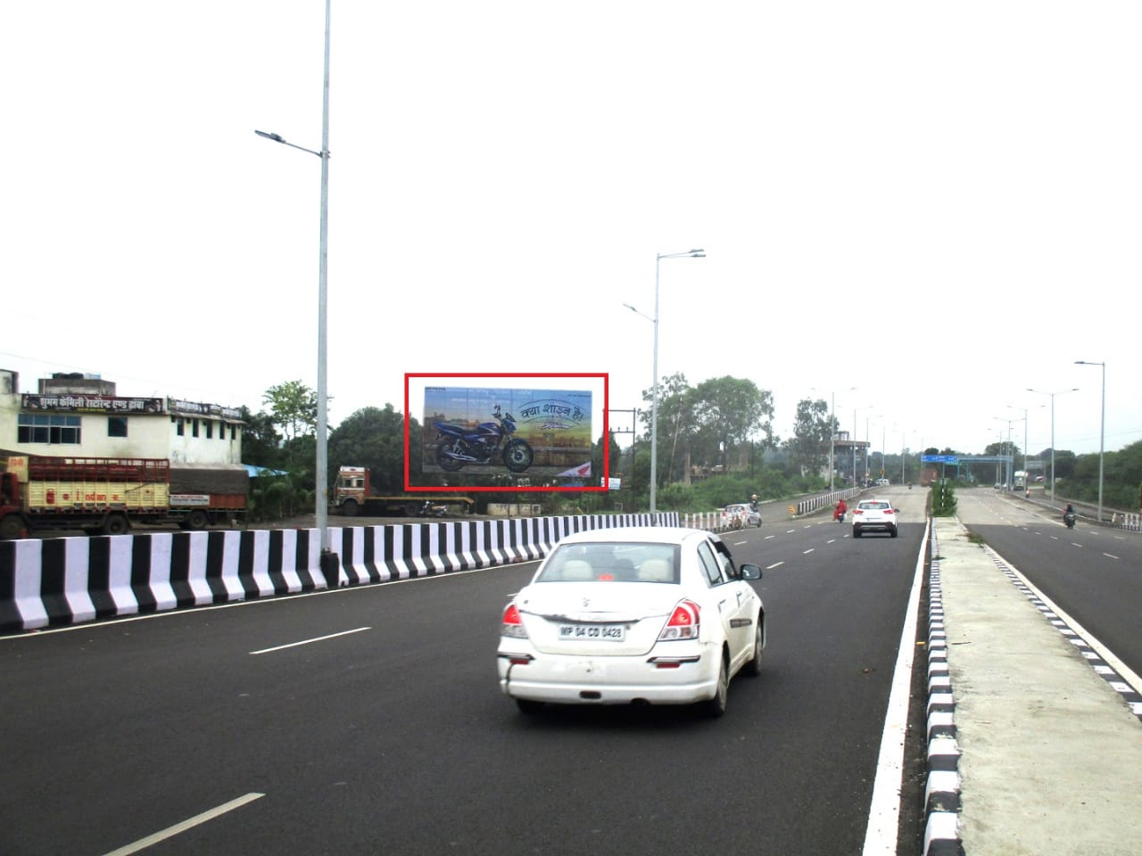
Near airport shyampur road facing bhopal 40x20
40X20 Rs 750000 /month Rs 3000/day
latitude longitude 23.3178361, 77.3171419

Slide 15
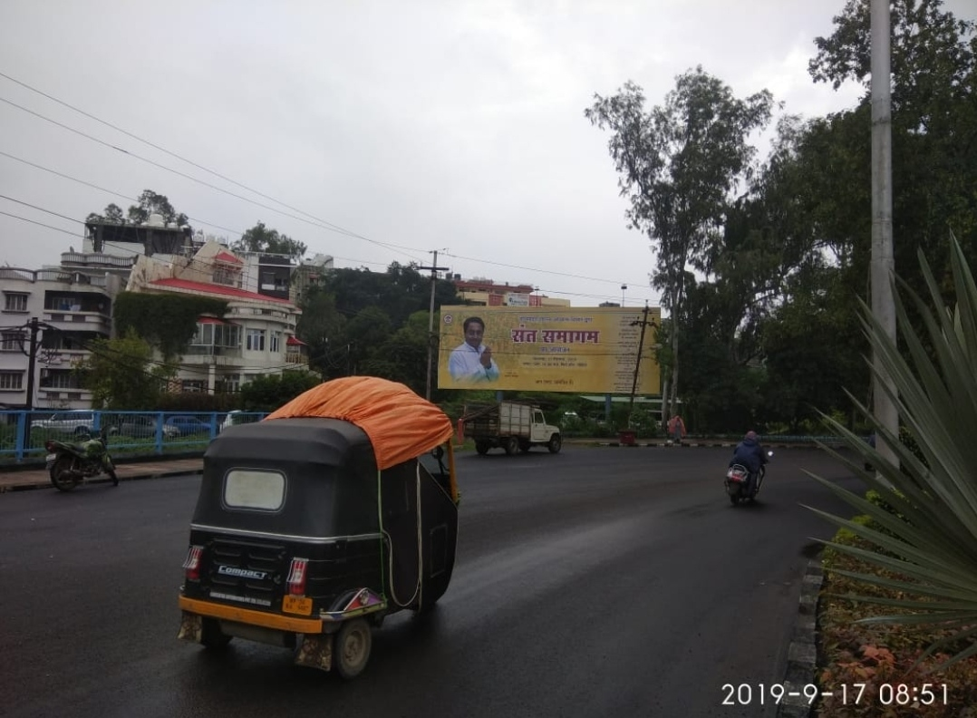
Vip road toward raja bhoj 50x30 - LIT
Rs 450000/month Rs 25000/day
latitude longitude 23.2609651, 77.3790592

Slide 16
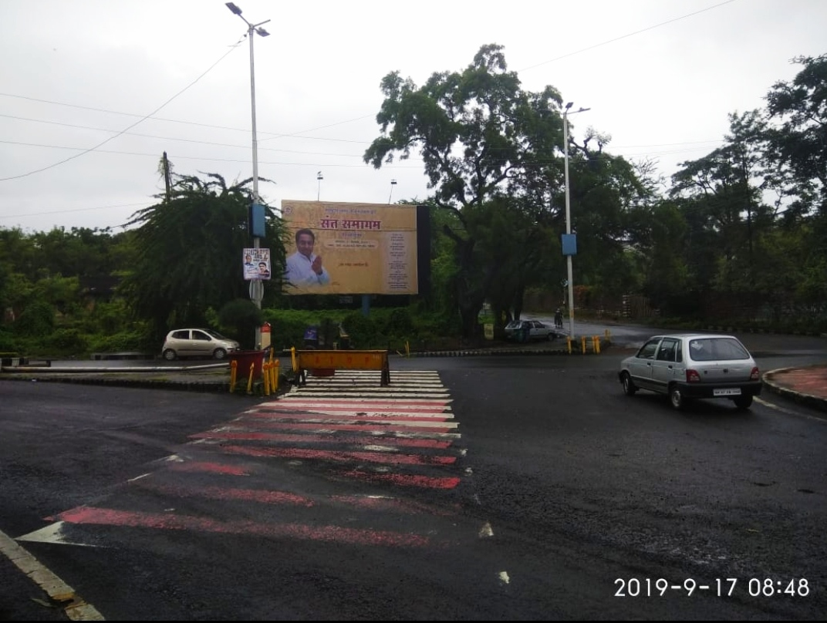
Vip road towards lalghati 30x30 LIT
Rs 350000 Rs 15000/day
latitude longitude 23.2607552, 77.3810297

Slide 17
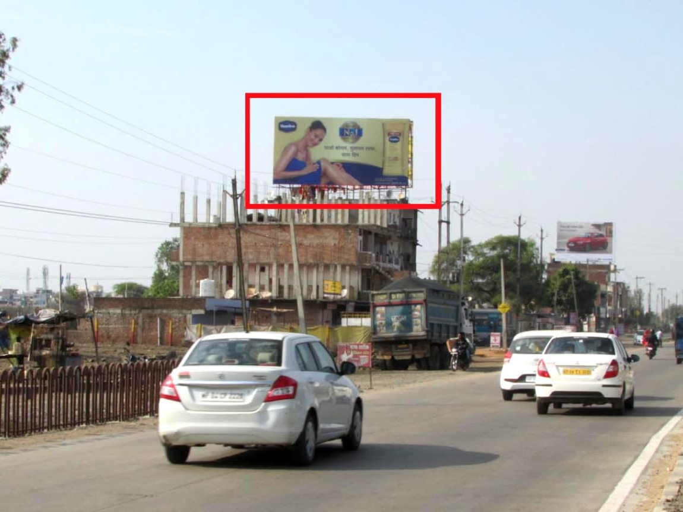
Samardha bhopal road facing mandideep 40x20 - NLIT
40X20 Rs 750000 /month Rs 3000/day
latitude longitude 23.1147050, 77.5069594

Slide 18
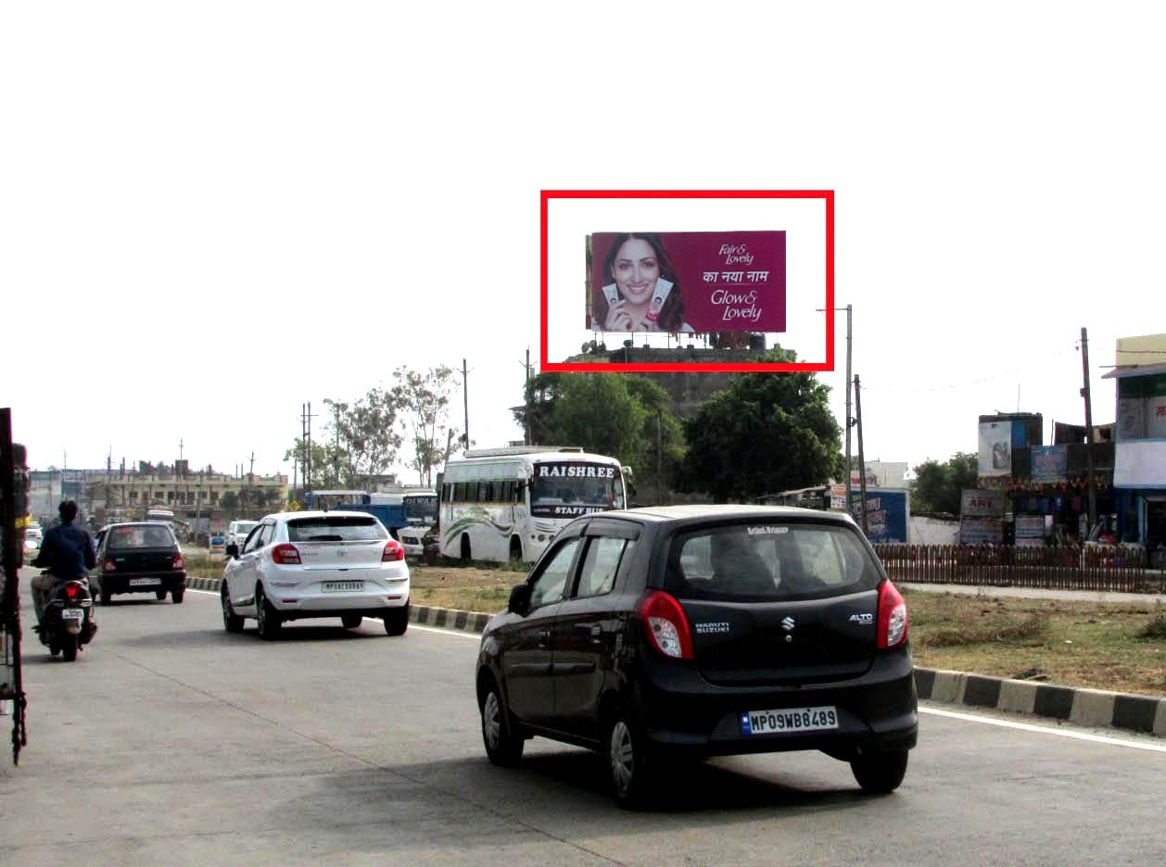
Samardha hoshangabad road facing mandideep 40x20 - NLIT
40X20 Rs 750000 /month Rs 3000/day
latitude longitude 23.1147050, 77.5069594

Slide 19
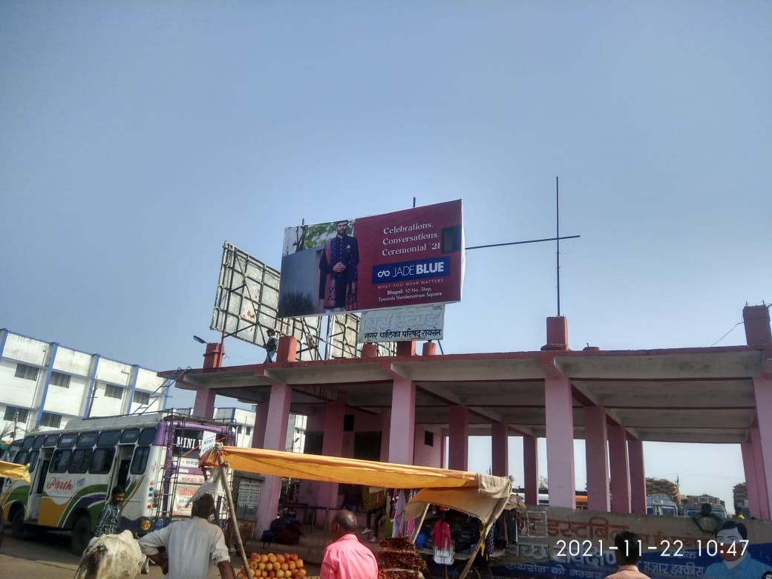
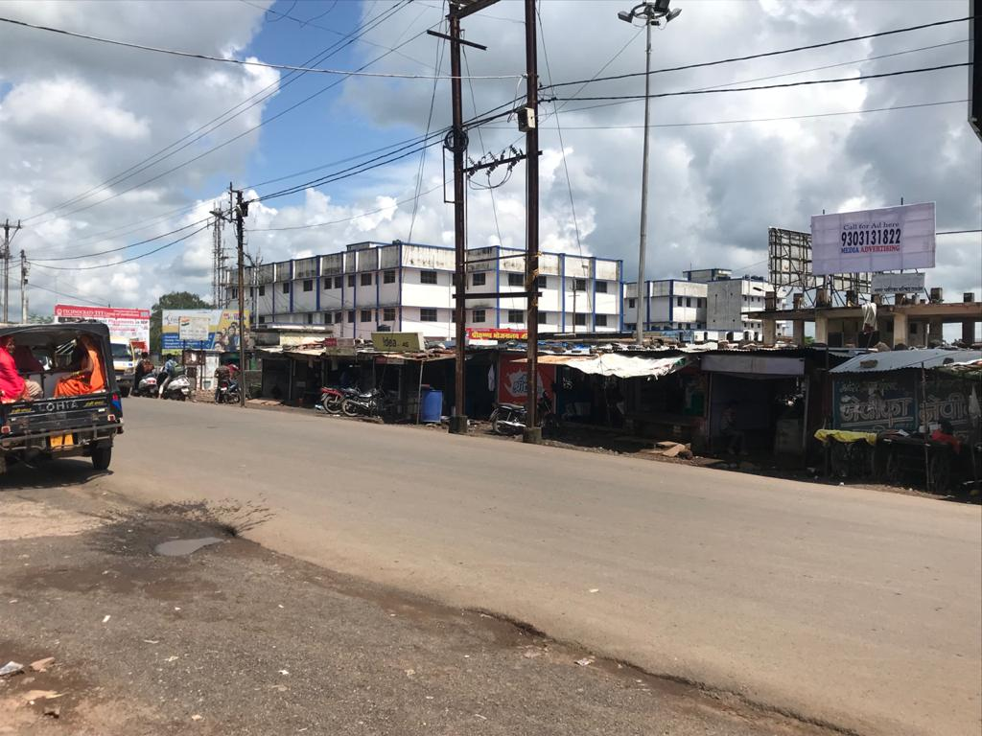
Raisen Bus stand 20x10 – NLIT
Rs 15000/month Rs 800/day latitude longitude 23.3278967, 77.7833706

Slide 20
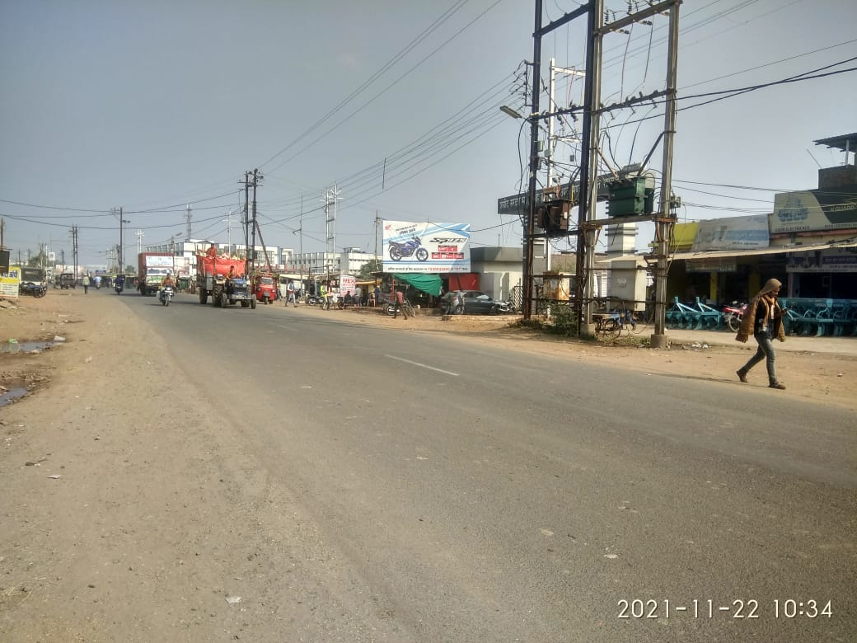
Raisen Galla mandi Bus stand Road - NLIT
20x10
15000/month Rs 800/day latitude longitude 23.3228045, 77.7836960

Slide 21
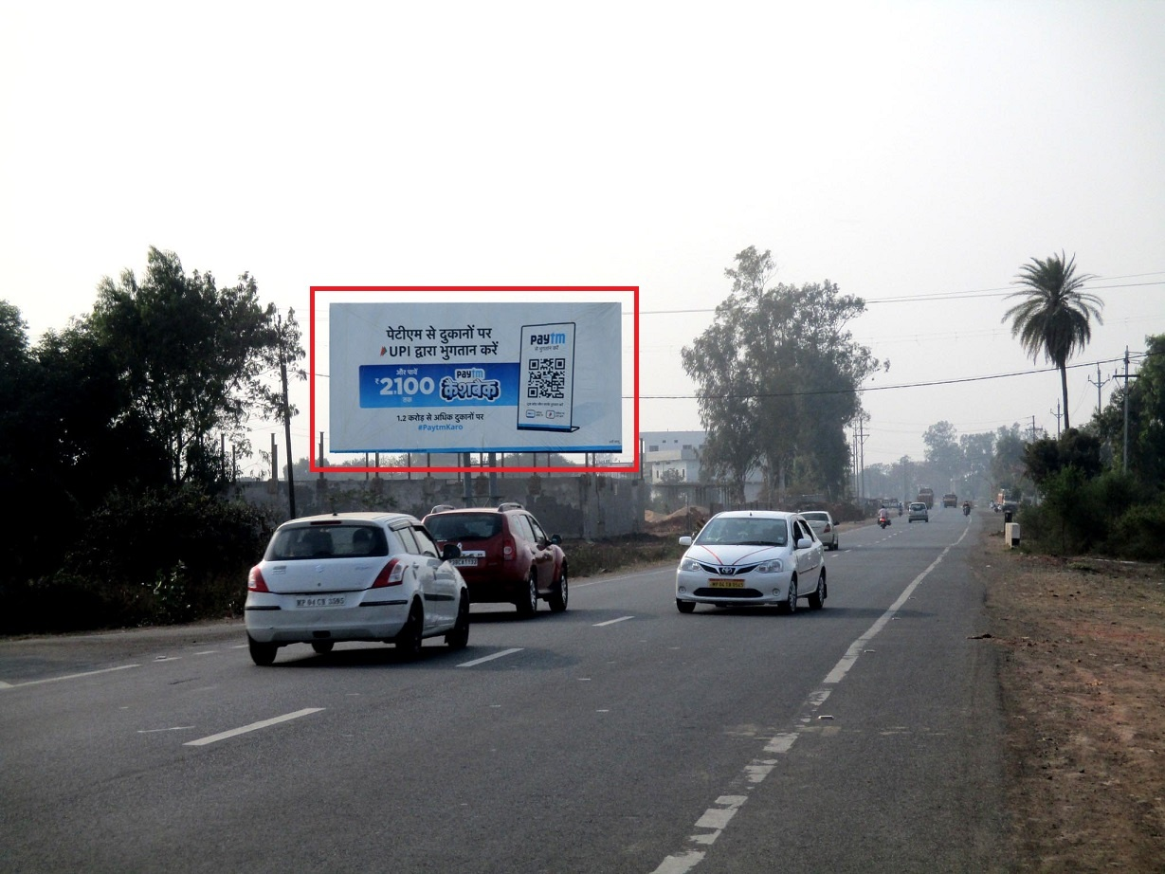
Sam college raisen road facing raisen– 40x20 – NLIT
40X20 Rs 750000 /month Rs 3000/day
latitude longitude 23.2522100, 77.5281841

Slide 22
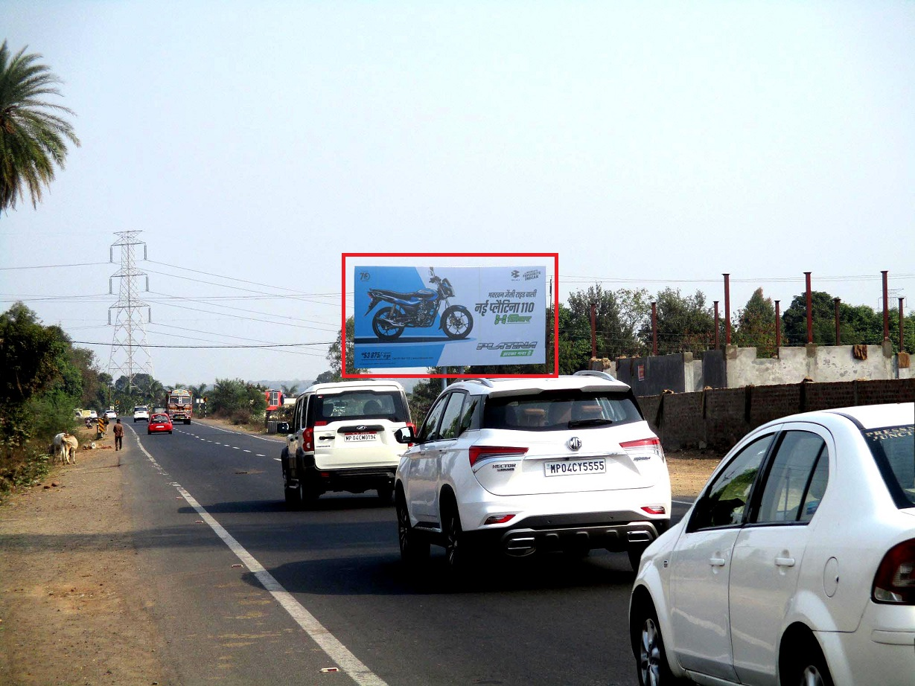
Sam college raisen road facing bhopal– 40x20 – NLIT
40X20 Rs 750000 /month Rs 3000/day
latitude longitude 23.2522100, 77.5281841

Slide 23
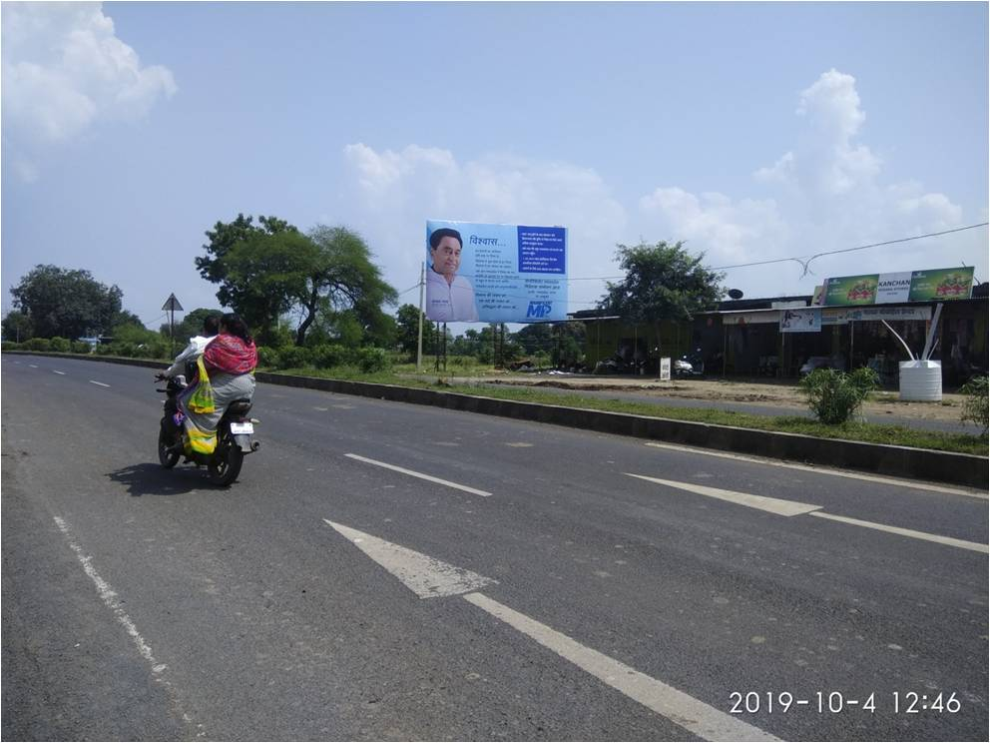
BHESA KHEDI BHOPAL TO INDORE HIGHWAY TOWARDS BAIRAGAR 30X20 - NLIT
SIZE : 30X20
Rs 80000/month Rs 3000/day
latitude longitude 23.2542489, 77.2784510

Slide 24
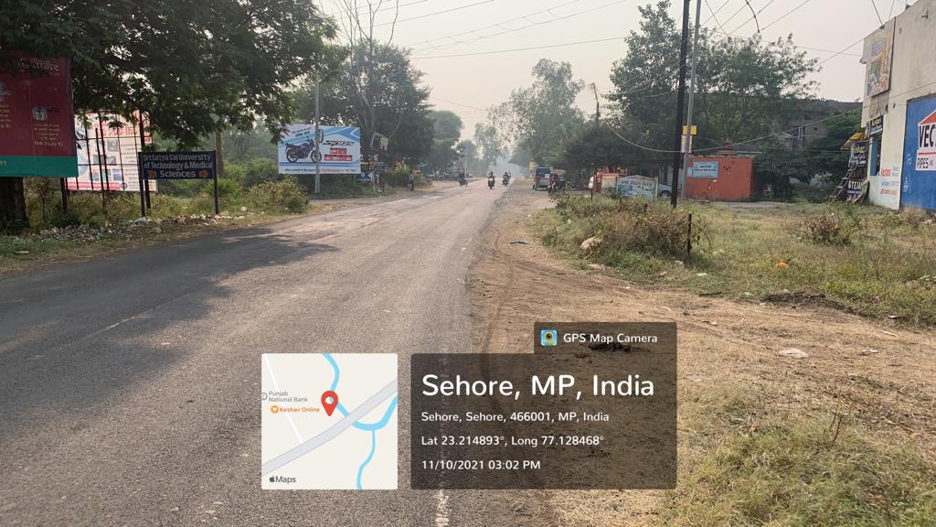
OPPOSITE SHRI SATYA SAI COLLEGE SEHORE - NLIT
20x10
15000/month Rs 800/day latitude longitude 23.214893 , 77128468

Slide 25
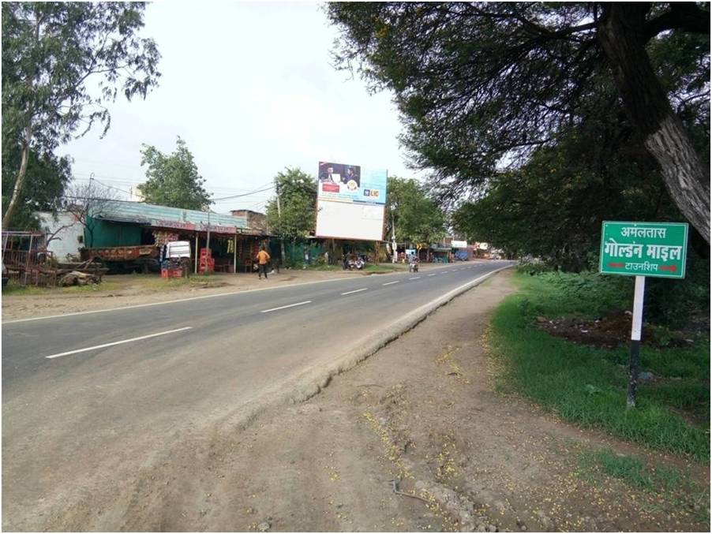
BHOPAL TO SEHORE ROAD NEAR PHANDA DISTRICT 20X20 - NLIT
Rs 20000 / month Rs 1000/day
latitude longitude 23.2290809, 77.2105792

